Slide 1
MSA Candlelight Research Update 2025
Edinburgh May 2025

Slide 2
Contents
MSA primer
Research Updates
MSA Trust work and projects
Focus on end-of-life review in MSA; UK survey

Slide 3
Multiple System Atrophy
A complex constellation of symptoms
Dysphonia and dysarthria
Dysphagia
Postural hypotension
Painful dystonia
Refractory pain
Bladder symptoms
Disordered sleep
Cognition and mood

Slide 4
Multiple System Atrophy
Affects the whole person
Affects family
Can feel very isolating to have a ‘rare’ disorder
Notes:
“Don’t you mean MS?
Mention my work…

Slide 5
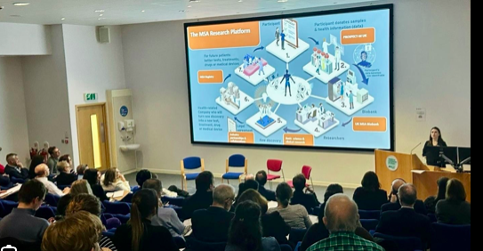
What is the MSA Trust about
To provide support and promote understanding on MSA for patients, families and their clinicians
To fundraise and support research
To understand MSA, its progression and improve clinical care
Aiming for a world without MSA

Slide 6
What are the MSA Trust aims?

Slide 7
Research Priorities Update
Finding the cause of MSA
Understanding clinical progression of MSA
Developing an evidence base
Disease modification
Biomarker identification
Symptom management
Mental health and Quality of Life
Notes:
These new priorities take into account the new diagnostic criteria which aim to diagnose people earlier. And now that trials are beginning to show promise in modifying the course of disease; trying to diagnose pwMSA faster and have reliable tests to assess whether treatments are working is key.
A particular passion of mine, that should be acknowledged throughout exciting developments is that people live with MSA and the symptoms it causes now. Therefore we need to work constantly to understand how MSA progresses better to treat people to maximise QoL. As a doctor who manges movement disorder and neurological palliative care, this remains a key need for the MSA community and the research we fund too

Slide 8
How we will meet our priorities
Funding research via MSA Trust Grant Award programme
Clinical Research Training programme (3rd fellow)
Collaboration
MSA Trust Research Symposium
Follow-up Funding programme
PhD Funding
Small Project Grants
Digital Tools and Data Utilisation

Slide 9
New Clinical Fellow: Dr Linda Lei
We are delighted to welcome Dr Linda Lei as the third ABN MSA Clinical Training Research Fellow.
Look out for updates in the Autumn MSA News when Linda will be explaining the research she will be undertaking over the next 3 years.
Notes:
he is currently a neurology trainee at the Royal Free Hospital and is excited to start her research in MSA.

Slide 10
Our previous Clinical Fellows
Dr Viorica Chelban
Dr Yee Yen Goh
Notes:
Dr Chelban-Key in PROSPECT and other trials coming out of this and hosts the annual MSA research symposium
Dr Goh-The second fellow has worked on PROSPECT and on biomarker work in CSF, blood, urine and skin

Slide 11
MSA Symposium 2025 UCL
Friday 25th April 2025
Meeting of professionals in MSA to update and network
Featured panels chaired by Dr Chelban and Dr Kobylecki as well as research round-ups
Notes:
Chelban-Global Genetics Research
Kobylecki-improving patient centred approaches

Slide 12
MSA Trust Grant Award Programme
Dr Conceicao Bettencourt, UCL
Oligodendrocyte DNA methylation patterns
Professor Jalesh Panicker, UCL
PAF conversion study
Professor Nigel Hoggard, Royal Hallamshire Hospital, Sheffield
Mitochondrial imaging
Dr Viorica Chelban, UCL
Genome wide association study
Assistant Professor Maria Xilouri, University of Athens, Greece
Autophagy-Lysosomal pathway work
Notes:
Bettencourt-DNA expression changes between healthy controls and pwMSA esp in oligodendroctres, a cell which myelinates and metabolically supports axons in the brain. New work looking at why oligodendrocyres are vulnerable in MSA to see if this leads to therapeutic avenues
Panicker One third convert from PAF to MSA after 6 yrs. Work with this group looking at what changes in this group and if this can lead to biomarkers or tests to find people in the early stages of disease
Hoggard-changes in the mitochondrial function (energy generating) of the brain in pwMSA using new forms of MR imaging
Chelban-the first fellow, identifying genetic changes in the genes of more than 1000 people with MSA
Xilouri-Looked at prtein deposition in pw MSA causing damage to loigodendrocytes. Now looking at whether the clearance system to remove proteins (Autophagy-Lyosymal Pathway) is impaired in MSA leading to accumulation and cell damage

Slide 13
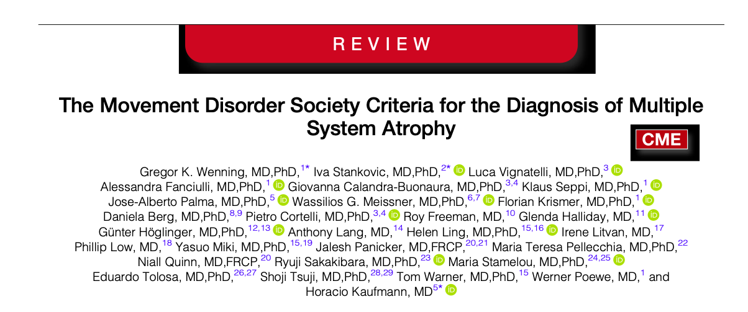
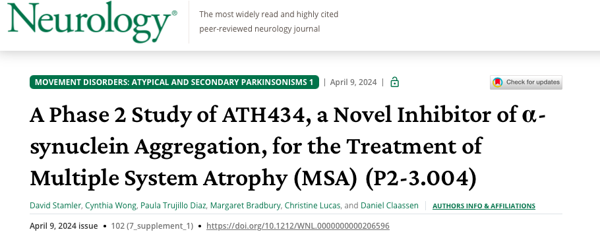
General MSA research update
Updated diagnostic criteria 2022
Improve patient and clinician certainty and improve research access
ATH434
PwMSA have increased brain iron accumulation in key sites; an emerging biomarker of disease
ATH434 reduced iron accumulation (secondary NFLC and ∝-synuclein)
Notes:
Replaces 2nd consensus criteria in use for 14yrs. This lacked sensitivity at early stages. More evidence driven
Now four levels of diagnostic certainty: Path established, clinically established, clinically probably and clinically possible. Also possible prodromal as research criteria-more autonomic features prior movement issues
Iron accumulation in MSA chiefly in putamen and cerebellar nuclei. In other parkinsonian conditions such as PSP iron is found more in other locations such as subthalmic nuclei. Phase 2 study showed iron reduced or stablised also NFLC and alpha synclein levels (end point brain iron via MRI) clinical via UMSARS. Tx group 48% slower progression over 52wks. 77 pts, over 6 countries. Idea does drug X affect disease Y. Phase 3 comparing tx with gold standard should be coming soonv

Slide 14
Update on clinical trials
CYPRESS (Theravance Biopharma): Phase 3 trial testing ampreloxetine for postural hypotension in MSA patients. Based on previous SEQUOIA trial which tested MSA, PD and other patients with postural hypotension
HORIZON: Phase 1 testing of safety and effects of genetic therapy markers for MSA
ATH434: Phase 2 trial of reducing iron deposition in the brain
MASCOT: Phase 3 trial testing of amlenetug, monoclonal antibody that targets extracellular α-synuclein
ExPRESS: Aims to improve early diagnosis and accurate prognosis of MSA and rare Parkinsonian conditions. Based on PROSPECT-M-UK

Slide 15
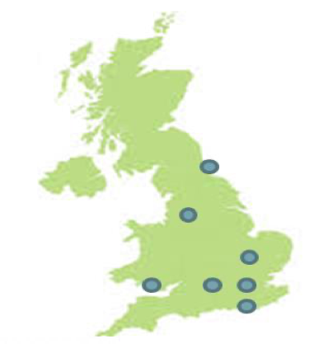
PROSPECT-M
Longitudinal study, multicentre
Progressive supranuclear palsy (PSP), corticobasal syndrome (CBS), multiple system atrophy (MSA) and related disorders
Understand progression of disease, create links to patients and researchers and collect data for onward research
progressive supranuclear palsy (PSP), corticobasal syndrome (CBS), multiple system atrophy (MSA) and related disorders
Notes:
Two hundred forty-three people were recruited [117 PSP, 68 CBS, 42 MSA and 16 indeterminate
Has published on survival trajectories and Qol and other clinical markers
Data collection continues looking for biomarkers of progression

Slide 16
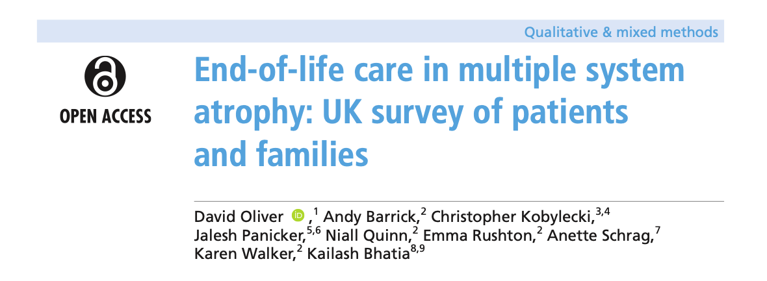
Quality of life and palliative care
Palliative care in MSA as well as disease modifying work
Are we nationally aware of palliative needs in MSA and is there resource and expertise?
Recent work by Oliver et al
Notes:
Difficulty funding palliative care in rare disorders such as my clinic
Results-520 responses (215 w MSA, 214 carers and 91 past carers). Around 75% have thought about what they want at end of their lives. 40% had discussed this with their dr or nurse and 80% valued that. For 40% of the former cares, death was unexpected. Very few had access to formalized PC. LPA was far more common than statement of wishes (58% vs 15%)

Slide 17
Summary
MSA is a far-reaching condition and needs multiple strategies:
Research into cause and progression
Seeking out biomarkers to diagnose more quickly and find targets for treatments
Work to best treat symptoms with evidence base to improve care
Being there with knowledge and expertise for those in the last phase of life
The MSA trust aims to end MSA by addressing all these needs

Slide 18
Thank you
To the patients and carers who live with MSA every day
MSA Trust staff and advisory panel
Participants, researchers and clinicians who work with MSA
To all of you today

